Slide 1
SymCLI and Unisphere for VMAX demo
For Customer Prudential UK
22nd April 2015

Slide 2
SymCLI basics

Slide 3
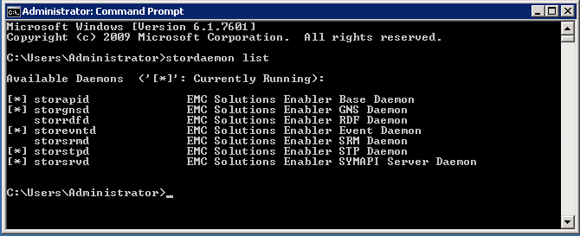
Daemons Installed and configurable when installing Solutions Enabler
Storwatchd: A watchdog daemon used on UNIX platforms
- stordaemon start <daemon>
- stordaemon restart <daemon>
- stordaemon shutdown <daemon>

Slide 4
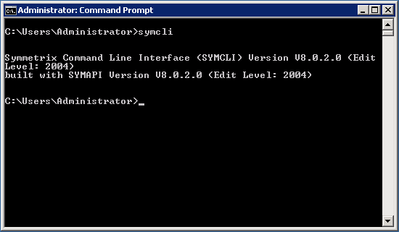
symcli

Slide 5
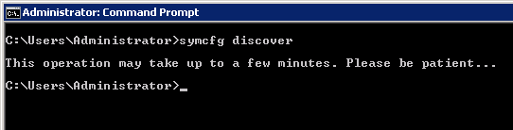
symcfg Rescan to update the symapi_DB.bin
File is located under <SE DIR>\symapi\db

Slide 6
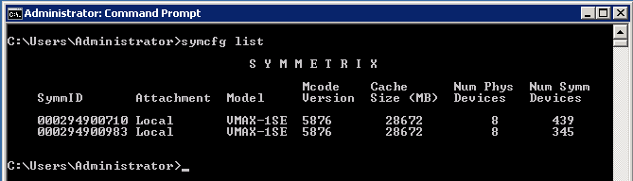
symcfg list VMAX specifications
- symcfg –sid <SID> list -v

Slide 7
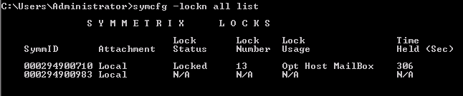
symcfg list locked configuration sessions
Lock 15 = standard reconfiguration lock
Lock 13 = symoptimizer lock

Slide 8
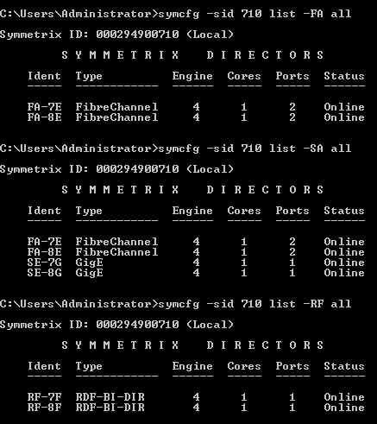
symcfg list all ports
symcfg –sid <SID> -EF all list
Limits the action to a FICON (Fibre-ESCON) director number

Slide 9
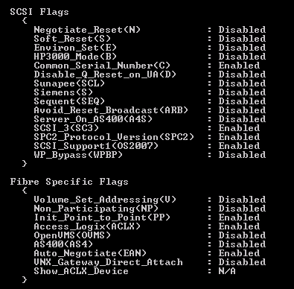
symcfg list port specifications symcfg -sid 983 -dir 7E -p 1 list -v

Slide 10
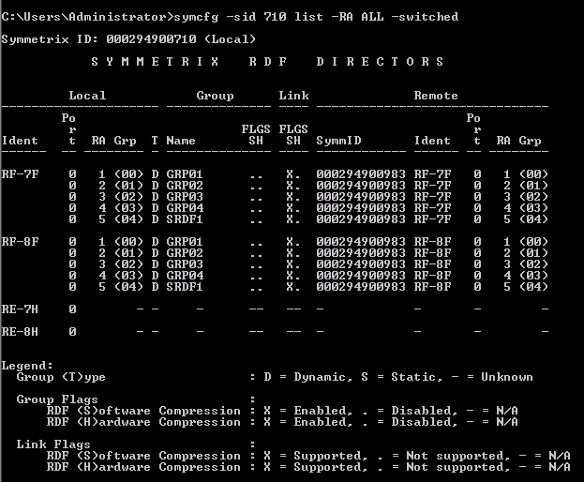
symcfg list RA specifications

Slide 11
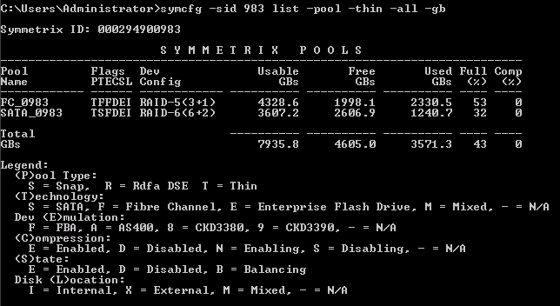
symcfg list thin pool specifications

Slide 12
symdev list all devices
symdev -sid <SID> list
[-FA <# | ALL> [-P <#>] | -SA <# | ALL> [-scsi] [-fibre] [-p <#>]]
[-devs <<SymDevStart>:<SymDevEnd> | <SymDevName> [,<<SymDevStart>:<SymDevEnd> | <SymDevName>>...]>]
[-cap <#> [-captype <mb | cyl>]] [-N <#>]
[-ficon]
[-noport | -firstport | -multiport] [-bcv | -nobcv | -drv]
[-meta] [-nomember]
[-disk_group <DskGrpNum> | name:<DskGrpName>]
[-emulation fba | ckd | ckd3390 | ckd3380 | as400 | celerra]
[-tdev [-bound | -unbound]] [-datadev [-nonpooled]]
[-technology <EFD | FC | SATA>]
[-R1] [-R2] [-R21] [-notrdf] [-rdfg <RdfGrpNum>]
list pd [ -FA <# | ALL> [-p <#>] |
list -lock

Slide 13
symdev manipulate individual devices
symdev -sid <SID> [-force] release [-lock <#>] [-noprompt]
symdev -sid <SID> show <SymDevName>
symdev -sid <SID> rw_enable <SymDevName> [[-SA | -FA] <# | ALL>[-P <#>]]
symdev -sid <SID> write_disable <SymDevName> [[-SA | -FA] <# | ALL>[-P <#>]]
symdev -sid <SID> ready <SymDevName>
symdev -sid <SID> not_ready <SymDevName>
symdev -sid <SID> hold <SymDevName>
symdev -sid <SID> unhold <SymDevName> [-symforce]
symdev -sid <SID> set -geometry <SymDevName>
-cyl <#> <-symm6|-symm7|-clariion|-sec_trk <#> -trk_cyl <#>>[-host_capacity <Blocks>]
symdev -sid <SID> pin <SymDevName>
symdev -sid <SID> unpin <SymDevName>

Slide 14
symconfigure create/change devs|pool|port ...
General syntax is:
symconfigure -sid <SID> [-v] [-file <CmdFile> | -cmd "Cmd"][-noprompt] preview|prepare|commit
file is used to run one type of command on multiple objects
cmd is used to run one command on one object or multiple contiguos objects
Symconfigure –sid <SID> query
To check if there are configuration sessions running

Slide 15
symconfigure - commands create devs
create dev count=<n>,size = <n> [MB | GB | CYL],
emulation=<EmulationType>,config=<DevConfig>[, data_member_count=<n>]
[, remote_config=<DevConfig>,remote_data_member_count=<n>,ra_group=<n>, [remote_mvs_ssid=<n>],[dynamic_capability =[dyn_rdf | dyn_rdf1_only | dyn_rdf2_only ]]
[,mvs_ssid=<n>, ][, attribute=<ckd_meta | savedev | datadev>
[in pool=<PoolName>][member_state=<ENABLE | DISABLE>] ]
[meta_member_size = <n> [MB | GB | CYL]][meta_config = [striped |concatenated]]
[, disk_group=<n> | name:<DskGrpName>,[remote_disk_group=<n> |name:<DskGrpName>]]
,[, binding to pool=<PoolName>[preallocate size = <ALL | n [ MB | GB |CYL]>]
[allocate_type = persistent][remote_pool=<PoolName>]]],
[,[mapping to dir <director_num:port>[starting] target = <scsi_target>,lun=<scsi_lun>, vbus=<fibre_vbus>[starting] base_address <cuu_address>]...]
[[device_attr =[SCSI3_persist_reserv |
ACLX]]...];

Slide 16
symconfigure - commands miscelaneous
Binding thin devices to a pool:
bind tdev <<SymDevName>[:<SymDevName>] | in DG <DgName> | in
SG <SgName>>to pool <PoolName><[preallocate size = <ALL | n
[MB | GB | CYL]>][allocate_type = persistent]>;
Unbinding thin devices from a pool:
unbind tdev <<SymDevName>[:<SymDevName>] | in DG <DgName> |
in SG <SgName>>from pool <PoolName>;
Deleting a Symmetrix device:
delete dev <SymDevName>[:<SymDevName>][, raidset = [TRUE |
FALSE]];
Forming a metadevice:
form meta from dev <SymDevName>,config=<meta_option>[, stripe_
size=<meta_stripe_size> [cyl] ][, count=<member_count>];
Adding a meta member:
add dev <SymDevName>[:<SymDevName>]to meta <SymDevName>[,
protect_data=[TRUE | FALSE],bcv_meta_head=<SymDevName>];
Dissolving a metadevice:
dissolve meta dev <SymDevName>[:<SymDevName>][[,<SymDevName>
[:<SymDevName>]]...];

Slide 17
symconfigure - commands miscelaneous (continued)
Mapping a device to an address, or mapping a range of devices to consecutive addresses:
map dev <SymDevName>[:<SymDevName>]to dir <director_num>:<port_
number>,[starting] [target=<scsi_target>,] lun=<scsi_lun>[,
vbus=<fibre_vbus>][, awwn=<awwn> | wwn=<wwn> | iscsi=<iscsi>| aiscsi=<aiscsi>] [, masking [host_lun=<lun> | dynamic_lun]]
[, emulation=CELERRA_FBA];
Mapping a range of devices to EA/EF (mainframe) ports:
map dev <SymDevName>[:<SymDevName>]to dir <director_num>:<port_number> ,starting base_address=<cuu_address>[mvs_ssid=<n>];
Unmapping a device:
unmap dev <SymDevName>[:<SymDevName>] from dir< ALL:ALL | ALL:<port_number> | <director_num>:ALL | <director_num>:<port_num> >
[, emulation=CELERRA_FBA] [, devmask_access = <remove | retain> ];
Unmapping a range of devices from EA or EF (mainframe) ports:
unmap dev <SymDevName>:[<SymDevName>] from dir< ALL:ALL |ALL:<port_num> | <director_num>:ALL | <director_num>:<port_num>> [new_ssid=<n>];

Slide 18
symconfigure - commands miscelaneous (continued)
Miscelaneous commands to manipulate:
tdevs
Reclaim start/stop
Datadevs
Draining
Enable/disable
savedevs
Thin pools
Creation
Extention
Setting attributes
.....

Slide 19
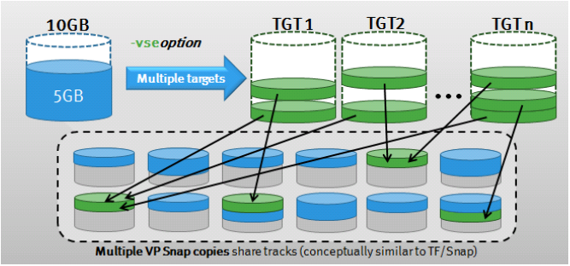
Clones and snapshots TimeFinder/Clone snap or snap VP control operations on a device group, composite group, devices within the device group, or devices in a device file.

Slide 20
symclone -vse All classical commands can be VP Snap commands by adding –vse Support of this feature is limited to Open Systems devices (FBA and AS400 D910 iSeries) and thin to thin device clone pairs
Create devices
Create a standard device group
Add src devices to the device group
Add tgt devices to the device group
Create VP Snap sessions
Activate VP Snap sessions
Query the result
Recreate the VP Snap sessions (-precopy, performs device copy in background)
Terminate the VP Snap sessions

Slide 21
symmir Performs Symmetrix BCV operations on a device group, composite group, devices within the group, or on devices within a file.
Symmir is able to perform the same commands as SNAP VP, but it works with BCV devices
For the latest micro codes, symmir is using clone emulation technology (not VP Snap!)

Slide 22
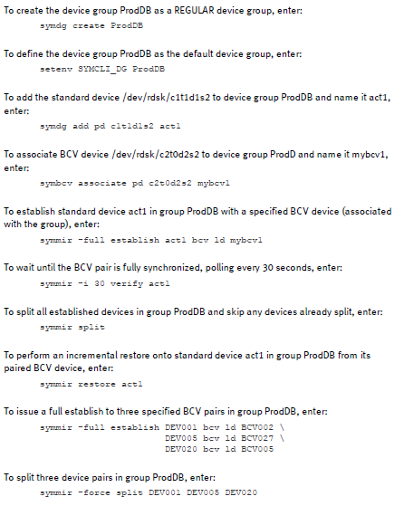
Symmir (examples)

Slide 23
symrdf Create (dynamic) RDF Groups
Zone SRDf ports in a 1 to 1 relationship inbetween 2 arrays
Create the RDF group, by specifying the local and remote dir’s
symrdf addgrp –label <label> -rdfg <GrpNum> -sid <SID> -dir <Dir> -remote_rdfg <GrpNum> -remote_sid <SID> -remote_dir <Dir>
symrdf modifygrp <-add | -remove> <-rdfg <GrpNum> | -label <GrpLabel>>
-sid <SID> [-dir <Dir>] [-remote_dir <Dir>]
symrdf removegrp -sid <SymmID><-rdfg <GrpNum> | -label <GrpLabel>>
Manipulate SRDF pairs
symrdf -file <Filename> -sid <SID> -rdfg <GrpNum>
createpair -type <R1 | R2> <-invalidate <R1 | R2> | -establish | -restore>
[-nowd] | -format [-establish]>[-rdf_mode <sync |semi | acp_wp | acp_disk | async>][-g <NewDg>] [-remote]
deletepair
establish [-full]
failback [-remote]
Split / restore / delete / suspend / ...

Slide 24
symaccess Performs Auto-provisioning Group operations on storage, initiator, and port groups. Allows you to create and manage masking views.
Create IG’s
symaccess –sid <SID> create –name <IG> -type init –wwn <WWN> -consistent_lun
Create SG’s
symaccess –sid <SID> create –name <SG> -type storage –devs <DEVs>
Create PG’s
symaccess –sid <SID> create –name <PG> -type port –dirport <DIR:p>
Create MV’s
symaccess –sid <SID> create view –name <MV> -ig <IG> -sg <SG> -pg <PG> -lun <Addr>
Rename entities
symaccess –sid <SID> rename -name <old> -type <TYPE> -new_name <NewGroupName>
symaccess –sid <SID> rename view –name <MV> -new_name <NewMV>
symaccess –sid <SID> rename –wwn <WWN> -alias <ALIAS=host/HBA>
symaccess –sid <SID> replace –wwn <WWN> -new_wwn <NEW_WWN>
List all logins
symaccess –sid <SID> list logins

Slide 25
Symfast Performs Fully Automate Storage tiering tasks
The symfast command provides the ability to perform the following actions:
Create a FAST policy
symfast -sid <SID> -fp create -name <FAST VP Policy>
Delete a FAST policy.
Add a tier to a FAST policy.
symfast -sid <SID> -fp add -tier_name <Tier> -max_sg_percent 10 -fp_name <FP>
Remove tiers from a FAST policy.
Modify a FAST policy.
Rename a FAST policy.
Associate a FAST policy to a storage group.
symfast -sid <SID> associate -sg <SG> -fp_name <FP> -priority <1|2|3>
Also possible with symsg
Disassociate a FAST policy from a storage group.
Modify a FAST policy and also its association.

Slide 26
Symtier Allows you to create and manage storage tiers that can be used for FAST policies.
Create a static disk group-provisioned storage tier, enter:
Create a dynamic disk group-provisioned storage tier, enter:
Create a virtually-provisioned storage tier, enter:
symtier -sid 207 create -name VPTier -tgt_raid1 -technology EFD -vp
Delete a storage tier, enter:
symtier -sid 207 delete -tier_name PrimeTier
Add a disk group to a disk group-provisioned storage tier, enter:
Add a thin pool to a virtually-provisioned storage tier, enter:
symtier -sid 207 add -tier_name VPTier –pool <POOL>
Remove a disk group from a disk group-provisioned storage tier, enter:
symtier -sid 207 remove -dsk_grp 1 -tier_name PrimeTier
Remove a thin pool from a virtually-provisioned storage tier, enter:
symtier -sid 207 remove -pool RemPool -tier_name VPTier
To rename a storage tier, enter:
symtier -sid 207 rename -tier_name PrimeDBTier -name PrimeTierR1

Slide 27
Symfast Performs Fully Automate Storage tiering tasks (continued)
Set FAST control parameters.
symfast -sid 207 set -control_parms -approval_mode AUTO_APPROVE -min_perf_period 100 -workload_period 200
Enable the FAST controller.
symfast -sid <SID> enable
Disable the FAST controller.
Query the FAST controller.
symfast -sid <SID> list -state
List the FAST VP tech demand report
symfast -sid <SID> list -technology ALL -demand -vp

Slide 28
symdg - symcg Performs operations on a Symmetrix device group.
symdg to work on devices comming from a single array
symcg to work on devices spanning multiple arrays (composite group)
To create a Symmetrix device group mydg_r1 of type RDF (R1), enter:
symdg -type RDF1 create mydg_r1
To show information about device group oradg_rdf1, enter:
symdg show oradg_rdf1
To export the device group to a file named oradg_rdf1.txt and then delete the device group, enter:
symdg -file oradg_rdf1.txt -delete export oradg_rdf1
To recreate the device group from the file oradg_rdf1.txt, enter:
symdg -file oradg_rdf1.txt import oradg_rdf1
To delete Symmetrix device group oradg_rdf1, regardless of whether the group has
members or associated gatekeeper or BCV devices, enter:
symdg -force delete oradg_rdf1
To write disable device DEV001 on Symmetrix director 16A and Port 0, enter:
symdg -g ProdDB -SA 16A -p 0 write_disable DEV001

Slide 29
symacl Sets up or updates Symmetrix access control lists.
symacl <-file <CommandFile> | <redirect_stdin>>[-v]
preview
prepare
commit [-force] [-restore]
symacl [-sid <SymmID | ALL>]
list [-v]
list [-accpool | -accgroup | -acl]
show accpool <PoolName> [-acl]
show accgroup <GroupName> [-acl]
Symacl backup -sid <SymmID> -file <CommandFile>
symacl -unique [-passphrase [<PassPhrase> | -file <PassFile>]]

Slide 30
symacl Command file syntax examples
To create a new pool:
create accpool <PoolName>;
To add devices to a pool:
add dev <StartDevName>[:<EndDevName>] toaccpool <PoolName>;
To remove devices from a pool:
remove dev <StartDevName>[:<EndDevName>] fromaccpool <PoolName>;
To delete a pool:
delete accpool <PoolName> [remove_aces=true];
To create a new access group:
create accgroup <GroupName>
To add an access ID to an access group:
add user accid <Id> name <IdName> to accgroup AdminGrp;
add host accid <Id> name <IdName> toaccgroup <GroupName>;
add restored accid <Id> name <IdName> toaccgroup <GroupName>;
add default accid name <IdName> to accgroup <GroupName>;
To remove an access ID from an access group:
remove accid name <IdName> from accgroup <GroupName>;
To move an access ID to an access group:
move accid name <IdName> to accgroup <GroupName>;
To delete an access group:
delete accgroup <GroupName> [remove_aces=true];

Slide 31

symacl Command file syntax examples (continued)
To grant an access control entry:
grant access=<AccessType,...> to accgroup <GroupName>for
<accpool <PoolName>> | ALL | <NON-POOLED devs>;
To remove access control entries:
remove access=<AccessType,...> fromaccgroup <GroupName>
for<accpool <PoolName>> | ALL | <NON-POOLED devs>;
remove aces from accgroup <GroupName>;
remove aces from accpool <PoolName>;

Slide 32
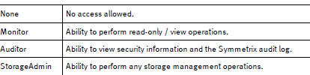

symauth Sets up or updates Symmetrix user authorization information.
symauth [-sid <SymmID>] [-noprompt] enable|disable
symauth [-sid <SymmID>] [-noprompt] set enforcement [advise | enforce]
symauth [-sid <SymmID>] [-offline]
list
list -users [-by_domain | -by_role | -by_user]
symauth list -roles
symauth list -components
symauth show -username
symauth [ -sid <SymmID> ] [-v | -noecho] [-noprompt][-file <CommandFile> |<redirect_stdin>]
preview
commit
symauth -sid <SymmID> backup -f <BackupFile>
symauth -sid <SymmID> commit -restore -f <BackupFile> [-noprompt]
The following roles are supported:

Slide 33
Miscelaneous Other useful SymCLI commands
symdisk
syminq
symlmf
symmigrate
symoptmz
sympd
symsan
symqos
symstat

Slide 34
Symcli
Q & A

Slide 35
Unisphere for VMAX classic basics

Slide 36
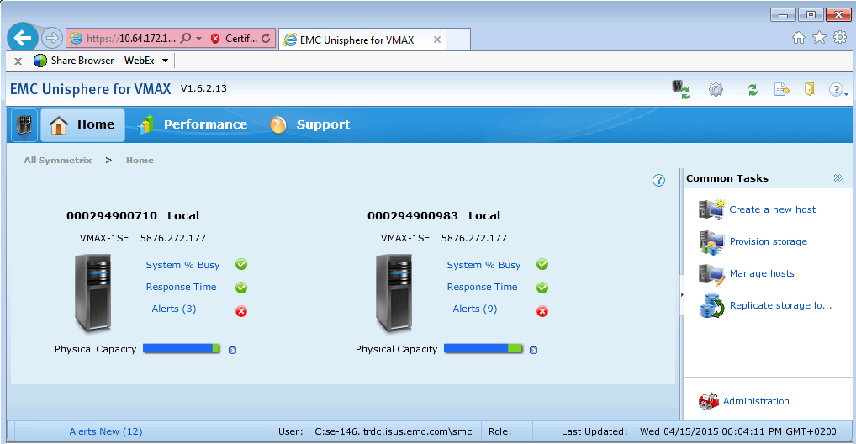

Slide 37
Unisphere for VMAX next gen basics

Slide 38
